Slide 1
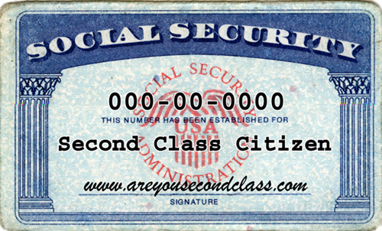
Microinsult Themes: (often unconscious) | Example | Message
Pathologizing Cultural Values and Communication Styles | Asking a black person, ”why do you have to be so loud/animated? Just calm down.” Asking Asian or Latino, “Why are you so quiet? We want to know what you think. Be more verbal.” | Assimilate to dominant culture Leave your cultural baggage outside
Second-Class Citizen | A person of color is mistaken for a service worker; A taxi-cab passes a person of color and picks up a white passenger A person of color is ignored at a store counter as attention is given to the white customer behind them | People of color are servants to Whites. They couldn’t possibly occupy high status positions Women occupy nurturing roles
Ascription of Intelligence | “You are a credit to your race.” “You are so articulate.” Asking Asians to help with math or science | People of color are generally not as intelligent as whites. It is unusual for women to be smart in math. All Asians are good in math/sciences.
Assumption of Criminal Status (Sue, Microaggressions in everyday life: Race, gender, and sexual orientation, 2010) | White person clutching their purse or wallet as a black or Latino approaches or passes; A store owner following a person around the store A white person waiting to ride the next elevator when a person of color is on it | You are a criminal. You are going to steal You are poor You do not belong You are dangerous
Notes:
:47-:50

Slide 2
Microinvalidation Themes: (often unconscious) | Example | Message
Aliens in Their Own Land | “Where are you from?” “Where were you born?” “You speak good English” | You are not American. You are a foreigner.
Color Blindness | “When I look at you, I don’t see color.” America is a melting pot. There is only one race, the human race. | Denying a person of color’s racial/ethnic experiences. Assimilate/acculturate to dominant culture. Denying the individual as a racial/cultural being
Denial of Individual Racism or Sexism | “I’m not a racist, I have several black friends.” “As a woman, I know what you go through as a minority” | I am immune to racism because I have friends of color. I am incapable of sexism.
Myth of Meritocracy | “I believe the most qualified person should get the job.” “Everyone can succeed in this society if they work hard enough.” | People of color are given unfair benefits because of their race. The playing field is even so if women or people of color cannot make it, the problem is with them
(Sue, Microaggressions in everyday life: Race, gender, and sexual orientation, 2010)
Notes:
:50-:53

Slide 3
How to React to Common Microaggressions
MICROAGGRESSION EXAMPLE AND THEME | THIRD PARTY INTERVENTION EXAMPLE | COMMUNICATION APPROACH
Alien in One’s Own Land To a Latino American: “Where are you from?” Ascription of Intelligence To an Asian person, “You’re all good in math, can you help me with this problem?” Color Blindness “I don’t believe in race.” | “I’m just curious. What makes you ask that?” “I heard you say that all Asians are good in math. What makes you believe that?” “So, what do you believe in? Can you elaborate?” | INQUIRE Ask the speaker to elaborate. This will give you more information about where s/he is coming from, and may also help the speaker to become aware of what s/he is saying. KEY PHRASES: “Say more about that.” “Can you elaborate on your point?” “It sounds like you have a strong opinion about this. Tell me why.” “What is it about this that concerns you the most?”
Myth of Meritocracy “Everyone can succeed in this society, if they work hard enough.” Pathologizing Cultural Values/Communication Styles Asking a Black person: “Why do you have to be so loud/animated? Just calm down.” | “So you feel that everyone can succeed in this society if they work hard enough. Can you give me some examples?” “It appears you were uncomfortable when said that. I’m thinking that there are many styles to express ourselves. How we can honor all styles of expression—can we talk about that?” | PARAPHRASE/REFLECT Reflecting in one’s own words the essence of what the speaker has said. Paraphrasing demonstrates understanding and reduces defensiveness of both you and the speaker. Restate briefly in your own words, rather than simply parroting the speaker. Reflect both content and feeling whenever possible. KEY PHRASES: “So, it sounds like you think…” “You’re saying…You believe…”

